Slide 1

ECE 281
Lesson 2
Maj Walchko, PhD
1

Slide 2
Lesson 2 Outline
Addition/Subtraction
Carry/Overflow
Negative Numbers
Logic Gates

Slide 3
Bitbucket
Create Private Bitbucket Repository
https://bitbucket.org/
Name repo something like “ECE281_YourName”
Give me access to repo. My Username: walchko
Example/Template Lab Notebook:
http://ece.ninja/383/lab/labnotebook.html
https://github.com/jfalkinburg/ECE_382_Lab_Ex/

Slide 4
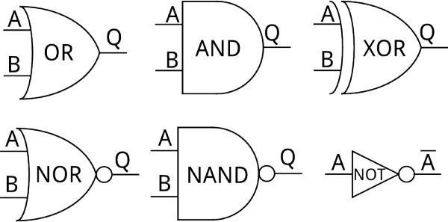
Simple Logic Overview
Combinational circuits are built of five basic logic gates:
AND gate - output is 1 if BOTH inputs are 1
OR gate - output is 1 if AT LEAST one input is 1
XOR gate - output is 1 if ONLY one input is 1
NAND gate - output is 1 if AT LEAST one input is 0
NOR gate - output is 1 if BOTH inputs are 0

Slide 5
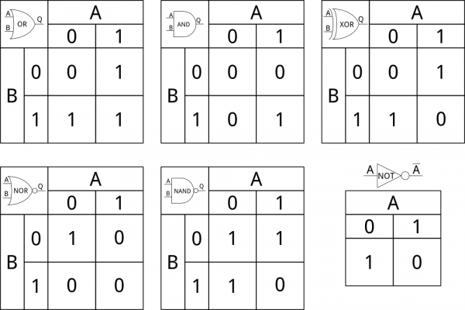
Logic Tables
These 1’s are really represented by voltage levels like 5V, 3.3V, 1.8V and 0’s are 0V

Slide 6
Exercise
Decimal | Binary | Hexadecimal
2007₁₀
 | 1 1011
 |  | 0xDEAD

Slide 7
Exercise
Decimal | Binary | Hexadecimal
2007₁₀ | 111 1101 0111 | 0x7D7
27₁₀ | 1 1011 | 0x1B
57005₁₀ | 1101 1110 1010 1101 | 0xDEAD
https://en.wikipedia.org/wiki/Hexspeak

Slide 8
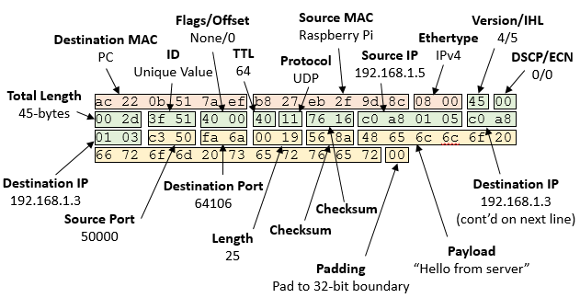
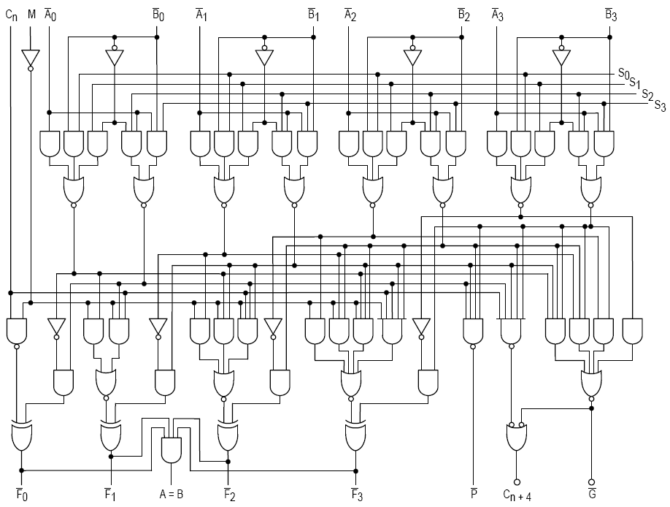
Math
Lower levels of programming (like assembly), the programmer needs to determine what the right answer is
Higher level languages (Python, C/C++, Ruby, etc) generally take care of this automatically
If you manipulate bits/bytes (like data through a network) you need to understand this
Writing drivers/working close to metal
We will talk about Arithmetic Logic Unit (ALU)
Using signed magnitude, 2’s complement, unsigned
Pro’s/Con’s
Addition
Subtraction
4b ALU for the 74181 IC

Slide 9
Number Conversions
Hex Digit | Decimal Equivalent | Binary Equivalent | Octal Equivalent
0 | 0 | 0000 | 0
1 | 1 | 0001 | 1
2 | 2 | 0010 | 2
3 | 3 | 0011 | 3
4 | 4 | 0100 | 4
5 | 5 | 0101 | 5
6 | 6 | 0110 | 6
7 | 7 | 0111 | 7
8 | 8 | 1000 | 10
9 | 9 | 1001 | 11
A | 10 | 1010 | 12
B | 11 | 1011 | 13
C | 12 | 1100 | 14
D | 13 | 1101 | 15
E | 14 | 1110 | 16
F | 15 | 1111 | 17
Copyright © 2007 Elsevier

Slide 10
Number Conversions
Decimal | 2’s Complement | Unsigned
-3 | 1101
-2 | 1110
-1 | 1111
0 | 0000 | 0000
1 | 0001 | 0001
2 | 0010 | 0010
3 | 0011 | 0011
Copyright © 2007 Elsevier

Slide 11
Carry/Overflow
Overflow – Overflow occurs when the answer is too big to fit in the available number of bit
It exceeds the range
The answer is not the correct sign (2’s Comp)
Carry – Whenever your answer takes more than a single bit, the extra bit is a carry.
Carry and Overflow are independent
They can occur at the same time
One can occur without the other
(this will probably make more sense as we continue on)
What is -5 + (- 6)?

Slide 12
backups

Slide 13
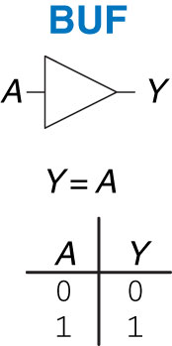
Buffer
Figure 1.13 Buffer

Slide 14
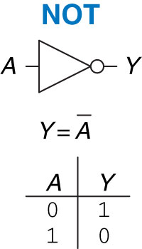
NOT Gate
Figure 1.12 NOT gate

Slide 15
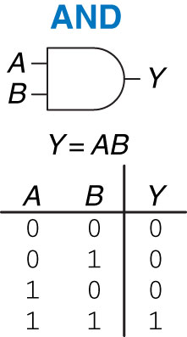
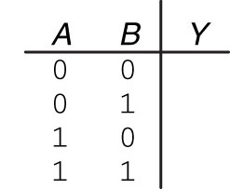
AND Gate
Figure 1.14 AND gate

Slide 16
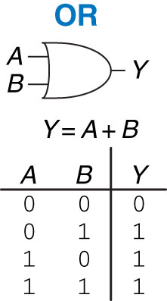
OR Gate
Figure 1.15 OR gate

Slide 17
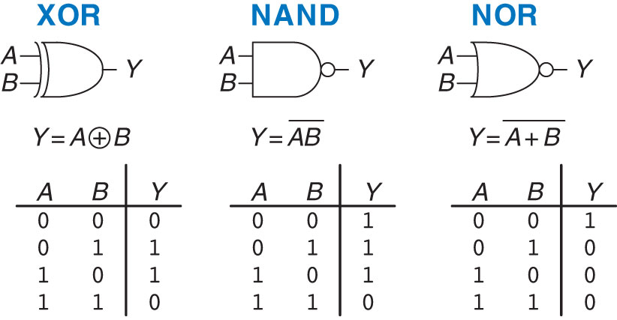
XOR, NAND, and NOR Gates
Figure 1.16 More two-input logic gates

Slide 18
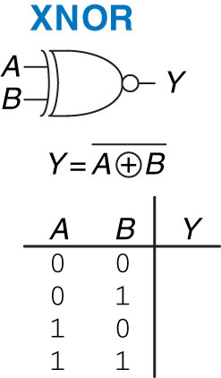
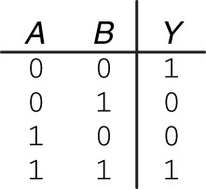
XNOR Gate
Figure 1.17 XNOR gate
Figure 1.18 XNOR truth table

Slide 19
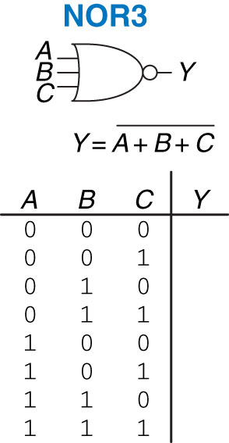
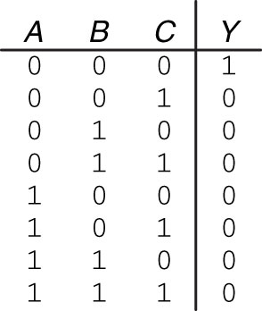
Three-input NOR Gate
Figure 1.19 Three-input NOR gate
Figure 1.20 Three-input NOR truth table

Slide 20
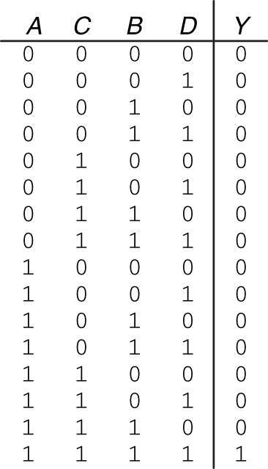
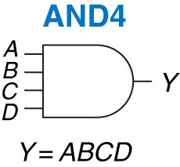
Four-input AND Gate
Figure 1.21 Four-input AND gate
Figure 1.22 Four-input AND truth table

